Slide 1
More Cache for Less Cash
Day: 1/10/14 Time: 1:45pm Location: Indigo Bay
In this session we will introduce the new Windows Azure Cache Service. This is the next generation cache technology for Windows Azure to replace the current Shared Caching service. During this session we will cover the new scenarios that the service enables in Windows Azure and the features that differentiate it from the legacy cache service. We will also demo how to provision and manage the new service.

Slide 2
More Cache for Less Cash
Michael S. Collier
@MichaelCollier
CodeMash – January 10, 2014

Slide 3


Michael S. Collier
Principal Cloud Architect, Aditi
michaelc@aditi.com
@MichaelCollier
www.MichaelSCollier.com
Notes:
Principal Cloud Architect
Windows Azure MVP
Help customers nationwide with their Windows Azure projects. This can include architectural design sessions, training, development, evangelism, etc.
Reach me via email, Twitter, or my blog.

Slide 4
UPCOMING Windows azure events
DevUnleashed
Saturday, February 8th
Microsoft – Columbus
Michael Collier, Samidip Basu, Jared Faris, or Mike Wood
Global Windows Azure Boot Camp
Saturday, March 29th
http://global.windowsazurebootcamp.com
Michael Collier, Brian Sherwin, or Mike Wood
CloudDevelop
Friday, August 15th 2014
Ohio Union – The Ohio State University
www.CloudDevelop.org / @CloudDevConf
Michael Collier or Jared Faris

Slide 5
Cloud / mobile user groups
Central Ohio Cloud Computing User Group
Windows Azure, AWS, Google, etc
2nd Monday of each month
6pm – 8pm
Improving Enterprises, Columbus
www.coccug.org
@coccug
Michael Collier
Windows Developer User Group
Windows Store & Windows Phone
3rd Monday of each month
6pm – 8pm
TechColumbus
http://thewindowsdeveloperusergroup.com/
@WindowsDevUG
Samidip Basu

Slide 6
Today’s Agenda
Why Cache?
Cache Options in Windows Azure
What’s New in the Windows Azure Cache Service
Demos
Monitoring and Scaling
Pricing and Features

Slide 7
Why Cache?
Load on server increases with users
Load Balancer
LB
Add a load balancer and more web instances
Web Tier
Continue to scale out the web and business logic tiers
Business Tier
DB load starts to increase, becomes the bottleneck
Data Tier
Notes:
SQL DB can often be a limiting factor in WA applications.
Can get slow and throttle as pressure increases

Slide 8
Why Cache?
Load Balancer
LB
Improve application performance
Web Tier
Business Tier
Reduce load on DB
Cache
Cache Tier
Data Tier

Slide 9

What is Windows Azure Cache?
A distributed, in-memory, flexible cache for all data types that can be used to speed up Windows Azure applications and reduce database load.
Windows Azure Cache
Basically, cache helps your app become faster.

Slide 10
A Cache Story
Shared Cache
Cloud Services
Cache Service
Cloud Services, Web Sites, or VMs
Shared – quotas
Lacked feature parity
Multiple size options
Expensive
Feature parity
Managed infrastructure
Price/capacity tiers
Good performance (1ms read)
Deprecated August 2014
Not multi-tenant
Good performance
Feature parity
Dedicated ($$)
Co-located (free)
Cloud Services
In-Role Cache
Performance challenged
Throttling
Notes:
Similar feature parity with Windows Server AppFabric Cache (on-premises)

Slide 11
A Cache Story
Shared Cache
Cloud Services
Cache Service
Cloud Services, Web Sites, or VMs
Shared – quotas
Lacked feature parity
Multiple size options
Expensive
Feature parity
Managed infrastructure
Price/capacity tiers
Good performance (1ms read)
Deprecated August 2014
Not multi-tenant
Good performance
Feature parity
Dedicated ($$)
Co-located (free)
Cloud Services
In-Role Cache
Performance challenged
Throttling
Notes:
Similar feature parity with Windows Server AppFabric Cache (on-premises)

Slide 12
A Cache Story
Shared Cache
Cloud Services
Cache Service
Cloud Services, Web Sites, or VMs
Shared – quotas
Lacked feature parity
Multiple size options
Expensive
Feature parity
Managed infrastructure
Price/capacity tiers
Good performance (1ms read)
Deprecated August 2014
Not multi-tenant
Good performance
Feature parity
Dedicated ($$)
Co-located (free)
Cloud Services
In-Role Cache
Performance challenged
Throttling
http://aka.ms/MigrateFromSharedCaching
Notes:
Similar feature parity with Windows Server AppFabric Cache (on-premises)

Slide 13

In-Role Cache (Co-located)
Web Roles
300MB
300MB
300MB
300MB
1.2GB Distributed Cache
Source: Windows Azure Training Kit

Slide 14
In-Role Cache (Dedicated)
Web Roles
12GB Cache
Worker Role
12GB Cache
Worker Role
24GB Distributed Cache
2
Source: Windows Azure Training Kit

Slide 15
In-Role Cache (Dedicated)
Web Roles
12GB Cache
Worker Role
12GB Cache
Worker Role
12GB Cache
Worker Role
12GB Cache
Worker Role
48GB Distributed Cache
24GB Distributed Cache
4
Source: Windows Azure Training Kit

Slide 16
In-Role Cache
Released w/ Oct. 2012 release of Azure SDK 1.8
Cache part of your Cloud Service application
No quotas or throttling
Isolation, flexibility, and control
High performance
Features: named cache, regions, tagging, HA, local, notifications
Pro: You manage as part of your application
Con: You manage it; only available to Cloud Service roles in same deployment
Notes:
A region is a subgroup for cached items. Regions also support the annotation of cached items with additional descriptive strings called tags. Regions support the ability to perform search operations on any tagged items in that region.

Slide 17
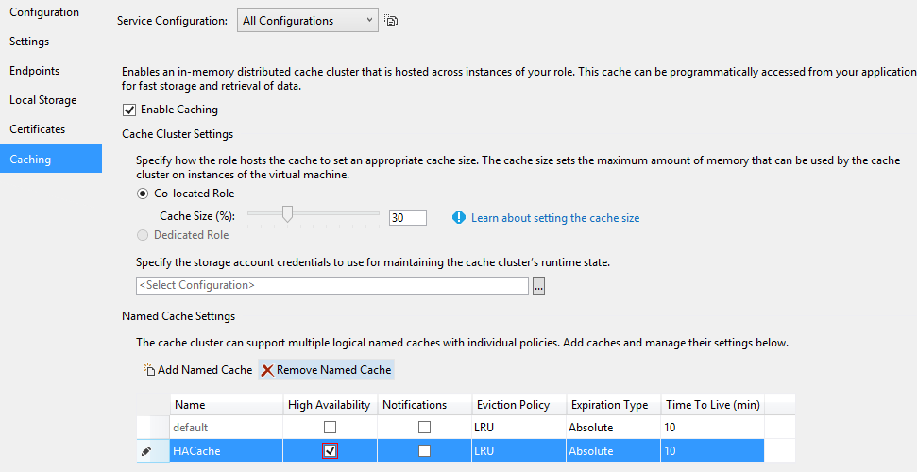
Create and Configure In-Role Cache
Configure a Role in the Cloud Service to host the cache

Slide 18
Configure the Cache Clients
Use NuGet to configure the cache clients
Microsoft.WindowsAzure.Caching
Settings placed in web.config or app.config
Modify to point to the cache server role
<dataCacheClients>
<dataCacheClient name="default">
<!--To use the in-role flavor of Windows Azure Cache, set identifier to be the cache cluster role name -->
<!--To use the Windows Azure Cache Service, set identifier to be the endpoint of the cache cluster -->
<autoDiscover isEnabled="true" identifier="MyScores.Web" />
<!--<localCache isEnabled="true" sync="TimeoutBased" objectCount="100000" ttlValue="300" />-->
</dataCacheClient>
</dataCacheClients>
Role Name

Slide 19

DEMO TIME!!!
Notes:
Add In-Role Cache to an existing Cloud Service
Show adding package via NuGet
Show pre-deployed version in management portal. Show metrics.
Install-package Microsoft.WindowsAzure.Caching

Slide 20
Monitoring the Cache
Diagnostic Level | Data Collected
0 | Critical/catastrophic server logs only
1 | Data to help in assessing usage patterns, cache health, and potential errors. Default.
2 | Fine grain data for all requests and important system information
3 | Diagnostic data with more verboseness and system information
4 | Highest verbosity logs for all requests and system information
Provides a single setting for cache servers and clients
Configures levels for logs, traces, performance counters & crash dumps
Full details at http://aka.ms/CacheDiagnostics
Notes:
http://msdn.microsoft.com/en-us/library/windowsazure/hh914135.aspx

Slide 21
Monitoring the Cache
Set cache diagnostic level in configuration or portal
Level (1-4) controls verbosity, perf counters, & crash dumps.
Start at 1 and increase as needed
<Role name="WorkerRole1">
<Instances count="1" />
<ConfigurationSettings>
<!– Cache Server -->
<Setting name="Microsoft.WindowsAzure.Plugins.Caching.DiagnosticLevel“ value="1" />
<!– Cache Client-->
<Setting name="Microsoft.WindowsAzure.Plugins.Caching.ClientDiagnosticLevel" value="1" />
</ConfigurationSettings>
</Role>
Full details at http://mcollier.net/AzureCacheDiag
Notes:
Server – added by Visual Studio
Client – added by NuGet package
http://msdn.microsoft.com/en-us/library/windowsazure/jj136940.aspx
http://msdn.microsoft.com/en-us/library/windowsazure/hh914135.aspx

Slide 22
Monitoring the Cache
public class WebRole : RoleEntryPoint
{
public override bool OnStart()
{
// Enable cache diagnostics
DiagnosticMonitorConfiguration dmConfig =
DiagnosticMonitor.GetDefaultInitialConfiguration();
// Configure collection of cache diagnostic data.
CacheDiagnostics.ConfigureDiagnostics(dmConfig);
DiagnosticMonitor.Start("Microsoft.WindowsAzure.Plugins.Diagnostics.ConnectionString",
dmConfig);
return base.OnStart();
}
}

Slide 23
Considerations
Unable to create DataCache in RoleEntryPoint
Max object size is 8MB post serialized
Default serializer is NetDataContractSerializer
Cost only for role instances
Only accessible from within same Cloud Service
Deployment will impact the cache (instances recycle)
Notes:
Unable to create DataCache in RoleEntryPoint
“Server collection cannot be empty”
WA Cache settings not automatically available in the web.cong in context of RoleEntryPoint
Programmatic only
http://msdn.microsoft.com/en-us/library/windowsazure/jj852128.aspx

Slide 24
What’s New in Windows Azure Cache?
App1
App2
Shared Azure Website Stamp
IaaS VMs
Cloud Services
Windows Azure Cache
SLA backed
Microsoft Managed
Scalable & Resilient
Notes:
Scale Units for Cloud Services

Slide 25
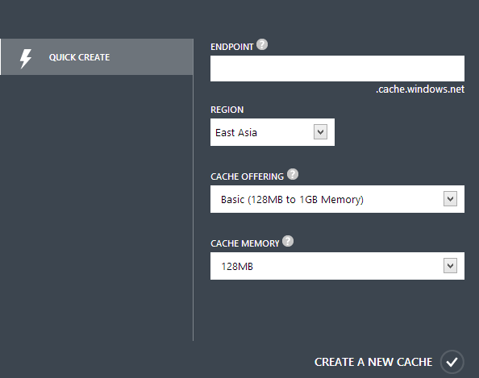
Create and Configure the Cache Service
Create via management portal
Choose an offering
Basic (128MB to 1GB in 128MB units, 1 named cache)
Standard (1GB to 10GB in 1GB units, notifications, and 10 named caches)
Premium (5GB to 150GB in 5GB units, notifications, HA, and 10 named caches)
Locate in same region as client for best perf and cost

Slide 26
DEMO TIME!!!
Notes:
Create a new cache in the cloud
Develop simple web app in VS and run against IIS express
Deploy to azure web site and run in cloud

Slide 27
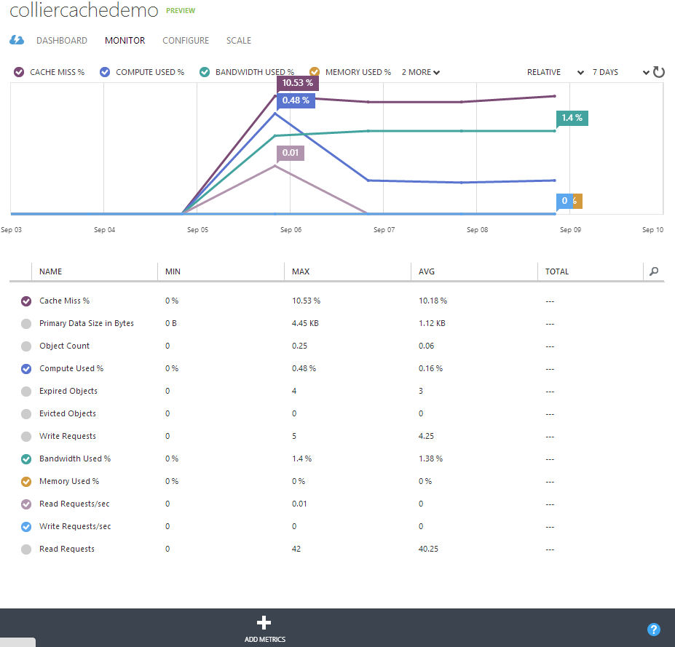
Monitoring the Cache

Slide 28
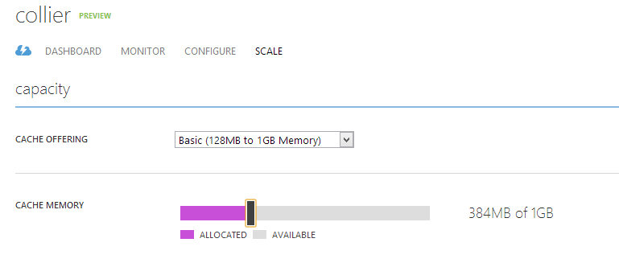
Scaling the Cache
Dynamically scale without loosing any existing data
Notes:
Scale cache units w/o losing data. Changing offerings will cause cache data loss.

Slide 29
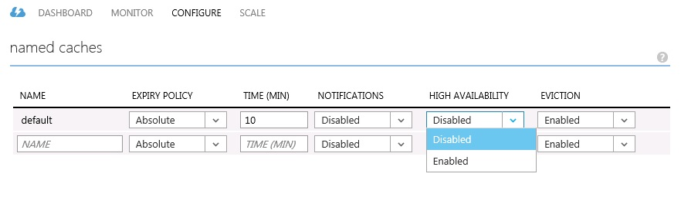
High Availability
Client
Read / Write
Primary
Premium only
Doubles required memory
Increased latency & decreased throughput
Write
Secondary

Slide 30
Where Can You Use the New Azure Cache?
 | Cloud Service | Windows Azure Web Site | Windows Azure VM | Windows Azure Mobile Service
.NET Applications | ✓ | ✓ | ✓
PHP (PECL) | ✓ | ✗ | ✓
Java (spymemcached) | ✓ | ✗ | ✓
Node.js | ✓ | ✗ | ✓ | ✗
C++ (libmemcached) | ✓ | ✗ | ✓
Hopefully addressed by GA

Slide 31
Pricing Details
 | Basic | Standard | Premium
Price Per Unit (Preview) | $12.50/month (prorated hourly) | $50/month (prorated hourly) | $200/month (prorated hourly)
Cache Size | 128 MB | 1 GB | 5 GB
Scale | Up to 8 units | Up to 10 units | Up to 30 units
Named Caches | 1 | 10 | 10
High Availability | ✗ | ✗ | ✓
Notifications | ✗ | ✓ | ✓
Price includes a 50% preview discount.
Technical support through forums only (during preview)
See http://mcollier.net/AzureCachePricing

Slide 32
Benefits of the Windows Azure Cache
Use from any app types (VM, Web Site, Mobile Service*, Cloud Service)
Each instance deployed within dedicated VMs (fast, predictable performance)
No quotas or throttling
Store up to 150GB per cache instance
Avg. retrieval time of 1ms. Insert in about 1.2ms
Highly available / distributed across multiple servers
Managed service – focus on apps not infrastructure
Same .NET cache API used with in-role cache for Cloud Services
Support for ASP.NET Session State and Page Output Caching
Unique cache service instance for each app, or share across apps
Notes:
Ability to use the Cache Service from any app type (VM, Web Site, Mobile Service, Cloud Service)
Each Cache Service instance is deployed within dedicated VMs that are separated/isolated from other customers – which means you get fast, predictable performance.
There are no quotas or throttling behaviors with the Cache Service – you can access your dedicated Cache Service instances as much or as hard as you want.
Each Cache Service instance you create can store (as of today’s preview) up to 150GB of in-memory data objects or content. You can dynamically increase or shrink the memory used by a Cache Service instance without having to redeploy your apps.
Web Sites, VMs and Cloud Service can retrieve objects from the Cache Service on average in about 1ms end-to-end (including the network round-trip to the cache service and back). Items can be inserted into the cache in about ~1.2ms end-to-end (meaning the Web Site/VM/Cloud Service can persist the object in the remote Cache Service and gets the ACK back in 1.2ms end-to-end).
Each Cache Service instance is run as a highly available service that is distributed across multiple servers. This means that your Cache Service will remain up and available even if a server on which it is running crashes or if one of the VM instances needs to be upgraded for patching.
The VMs that the cache service instances run within are managed as a service by Windows Azure – which means we handle patching and service lifetime of the instances. This allows you to focus on building great apps without having to worry about managing infrastructure details.
The new Cache Service supports the same .NET Cache API that we use today with the in-role cache option that we support with Cloud Services. So code you’ve already written against that is compatible with the new managed Cache Service.
The new Cache Service comes with built-in provider support for ASP.NET Session State and ASP.NET Output Page Caching. This enables you to easily scale-out your ASP.NET applications across multiple web servers and still share session state and/or cached page output regardless of which customer hit which server.
The new Cache Service supports the ability to either use a separate Cache Service instance for each of your apps, or instead share a single Cache Service instance across multiple apps at once (which enables easy data sharing as well as app partitioning). This can be very useful for scenarios where you want to partition your app up across several deployment units.

Slide 33
Common Architecture
Web Roles
2. Read
Storage Table
3. Write
1. Read
Windows Azure Cache
Notes:
Basic – cache-aside pattern

Slide 34
Common Architecture
Windows Azure Load Balancer
Web Roles
Worker Roles
Read
Write
Read
Preload the cache
Carefully choose expiration and eviction settings
Windows Azure Cache
SQL Database (Windows Azure)
Notes:
Pre-load the cache

Slide 35
Common Architecture
Windows Azure Load Balancer
Web Roles
Storage Queue
Worker Roles
Write
Read
Write
Write
Read
Write
Windows Azure Cache
Storage Table
SQL Database (Windows Azure)
Notes:
Architecture diagram – read from cache; other process updates cache data
Reference - http://blog.cynapta.com/2013/11/building-cynapta-services-part-ii-architecture-drilldown/

Slide 36
Guidelines - Configuration
Multiple named caches for different cache settings (HA, notifications, TTL, etc.)

Slide 37
Guidelines - Features
Local Cache
Pro:
Fastest performance
Con:
Stale data (compensate w/ notification invalidation)
Additional memory pressure

Slide 38
Guidelines – High Availability & Regions
High Availability
Pro: More durable cached data
Con: 2x the writes (memory / performance)
Regions
Pro: Supports organization, tagging, and searching
Con: Lives on a single cache server

Slide 39
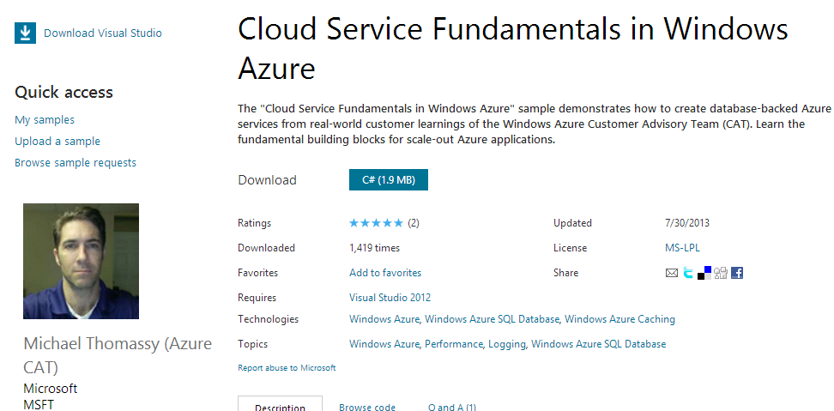
Cloud Service Fundamentals - Caching
Factory implementation
Custom BinarySerializer class
protobuf-net
Fast and small
http://mcollier.net/AzureCSF
Notes:
http://blogs.msdn.com/b/windowsazure/archive/2013/10/03/cloud-service-fundamentals-caching-basics.aspx

Slide 40
Where to Cache?
 | Cache Service | In-Role Cache
Usage Scenarios | Cloud Services, Mobile Services, Web Sites, and VMs | Cloud Services
Pricing | Pay per Month | Co-located – free Dedicated – pay per hour
SDK/Language Support | .NET SDK | .NET SDK
1 Medium Cloud Service instance (3.5 GB RAM): $119/month
2 GB Standard cache (2, 1GB units): $100/month
3 A7 dedicated instances (56 GB RAM each): $3,147/month
150GB Premium cache (30, 5GB units): $6,000/month

Slide 41
Where to Cache?
Mix cache solutions for price / manageability / features
Windows Azure Load Balancer
Web Roles
Data shared by other services/apps
General application data
Read
In-role cache
Windows Azure Cache
Session / Page Output Cache
FREE!

Slide 42
Summary
In-Role Cache
Cloud Services only
Co-located (free) or Dedicated ($$$)
Isolated cache-related workload
Cache Service
Microsoft managed service, dedicated tenant, SLA backed
Cloud Services, Web Sites, and VMs
Full parity with in-role cache (SDK)
Shared Caching Service to be deprecated
No later than August 29th, 2014

Slide 43
More Resources
Scott Guthrie’s blog
http://weblogs.asp.net/scottgu/archive/2013/09/03/windows-azure-new-distributed-dedicated-high-performance-cache-service-more-cool-improvements.aspx
Windows Azure Cache Service (Preview)
http://msdn.microsoft.com/en-us/library/windowsazure/dn386094.aspx
Optimization Guidance for Windows Azure Caching
http://msdn.microsoft.com/library/hh916611.aspx
Windows Azure Cache Sample
http://code.msdn.microsoft.com/Windows-Azure-Caching-NFL-e2a534a5
Cloud Service Fundamentals – Caching Basics
http://blogs.msdn.com/b/windowsazure/archive/2013/10/03/cloud-service-fundamentals-caching-basics.aspx
Capacity Planning Spreadsheet
http://msdn.microsoft.com/en-us/library/hh914129
Notes:
Cache (Preview) Features - http://msdn.microsoft.com/en-us/library/windowsazure/dn386143.aspx

Slide 44
Q & A
Ask your questions

Slide 45
Thank You!
Michael S. Collier
Principal Cloud Architect, Aditi
michaelc@aditi.com
@MichaelCollier
www.MichaelSCollier.com
Notes:
Principal Cloud Architect
Windows Azure MVP
Help customers nationwide with their Windows Azure projects. This can include architectural design sessions, training, development, evangelism, etc.
Reach me via email, Twitter, or my blog.

